Slide 1
5100-Final Presentation
——by Sicheng Zhang, Li Guo and Shu Zhang

Slide 2
Problem Statement:
Notes:
Would you like to guess where it is? It is Beijing, the capital city of China. And don’t worry there is nothing on fire, it is not smoke but just polluted air that every Beijingnese has to bare with every single day.

Slide 3
Problem Statement：
Notes:
Obviously， Beijingnese are not the only people that suffered from terrible urban environment. Here is a photo of the Gange River, seems the Indians are in trouble as well.

Slide 4
Problem Statement:
Inefficient information distribution;
Problems are realized too late to be fixed;
Slow or No responds to issues;
High costs in urban planning, but low payback;
Not only environment but what about the other aspects?! They are LINKED!
Notes:
All three of us are from big cities in China, we experienced both pros and cons of living in a city. However, it seems urban planning is always a big issue: the information among governments are distributed in a very low efficiency; problems are realized too late to be fixed. Taking the air pollution in Beijing as an example, it could be noticed and cured in early stage. There are so many indexes or signs ignored or deferred by related institutes and now we have to breathe in such bad air, spending way more budgets in fixing this problem and risk our health, suffer from it.
Environment is just one aspect of urban planning, other aspects of it generates issues as well, the most important thing is these factors or issues never exist independently. The have causal effect on each other and related convolutedly.

Slide 5
Our Approach -A smart urban planning system
Connects governments from all jurisdiction levels with different data collecting institutes
It can bring in all data into the system
Real-time tracking the cities and monitor if the city is in a good healthy trend.
Catch abnormal data
Transferring work requests among departments or institutes
Calculate different indexes Generates reports and advices for cities in need
Notes:
Therefore, we came up with the idea of building a system that connects governments from all jurisdiction levels with different data collecting institutes. Our algorithm is inspired by the idea of Big Data, which is bring in all data into the system, real-time tracking the cities and monitor if the city is in a good healthy trend. It will collecting large amount data, analyzing them with statistical methods. With calculated results, it will be able to catch the abnormal data, transferring work requests among departments or institutes, calculate different indexes and eventually generates reports and advices for cities in need. Due to the time frame restriction, it may not possibly implement a fully matured system with the huge amount calculation, but we tried our best to keep the system’s core algorithm to be as similar to the real one as possible and focused on implementing the overall system structure.

Slide 6
Before start: sth about our project
Data Generation
Normal Distribution
Tried to make data look more real
More reliable for program testing purpose
Data Validation
Regular expression & Key Listener. consume & Exceptional handling
All indexes or ratios (two decimal formats) for more readable outcome
User friendly UI design
Notes:
Approach-how to solve the problem

Slide 7
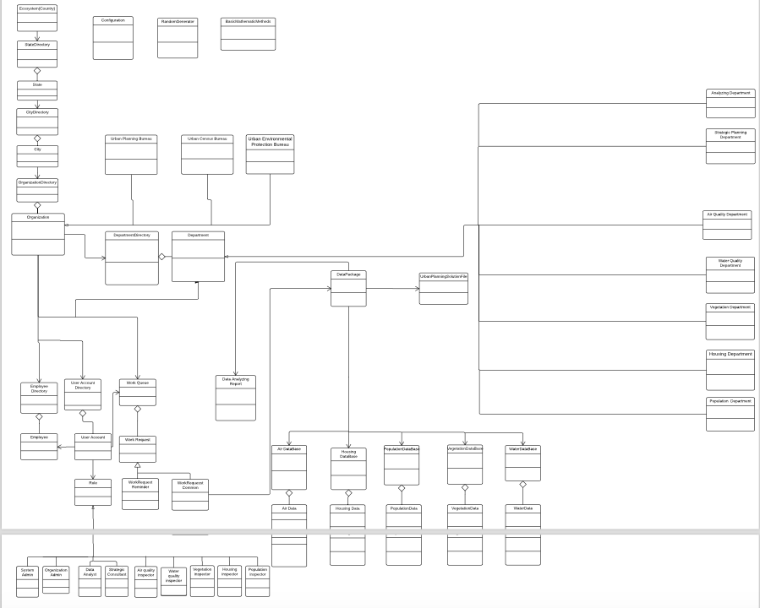
Object Model

Slide 8
Steps
System Admin Role
System Admin creates State, city and organization
System admin add AND ASSIGN USERACCOUNT FOR organization admin
Organization ADMIN role
Organization ADMIN LOG IN
ORGANIZATION ADMIN CREATES DEPARTMENT AND EMPLOYEE AND ASSIGN USERACCOUNT FOR EMPLOYEE
ORGANIZATION ADMIN VIEW REQUEST FROM other organization ADMIN AND PROCESS REQUESTs BY ASSIGNING TO PARTICULAR EMPLOYEE
ORGANIZATION ADMIN VIEW REQUEST reminder FROM EMPLOYEE, APPROVE AND GO TO REPORT THE REQUEST TO other organiazation admin

Slide 9
STEPS
INSpecTOR & MANAGER
INPUT REAL-TIME DATA AND SEND REquest TO ORGANIZATION ADMIN IF THERE IS An UNHEALTHY TREND of THE CITY STATUS
vIEW AND PROCESS REQUEST FROM ORGANIZATION ADMIN BY SENDING PARTICULAR DATAPACKAGE BACK
dATA ANALYST
VIEW AND ANALYZE REQUEST ASSIGNED BY ORGANIZATION ADMIN BY COLLECTING DATA FROM EACH DEPARTMENT
GENERATE AND UPLOAD ANALYZING REPORT TO STRATEGIC DEPARTMENT
sTRATEGIC PLANNING CONSULTANT
VIEW REPORT FROM ANALYZING DEPARTMENT AND GENERATE STRATEGIC REPORT
UPLOAD THE REPORT

Slide 10
Urban Planning Organization
Urban Environmental Organization
Urban Census Organization

Slide 11
Trigger:
Urban Planning Organization
Notes:
Example 1(详谈)

Slide 12
Trigger:
Population Department
(Urban Census Organization)
Notes:
Example 2(详谈)

Slide 13
Trigger: Air Department
(Urban Environmental Organization)

Slide 14
Screen shots of key usecase

Slide 15
Organization Admin create employee and assign a useraccount for each one
Notes:
最好有两页拉近看。。

Slide 21
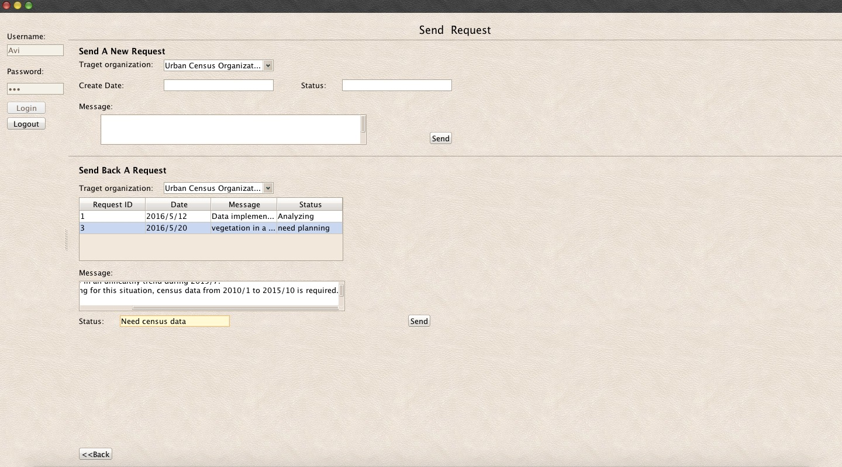

Slide 22
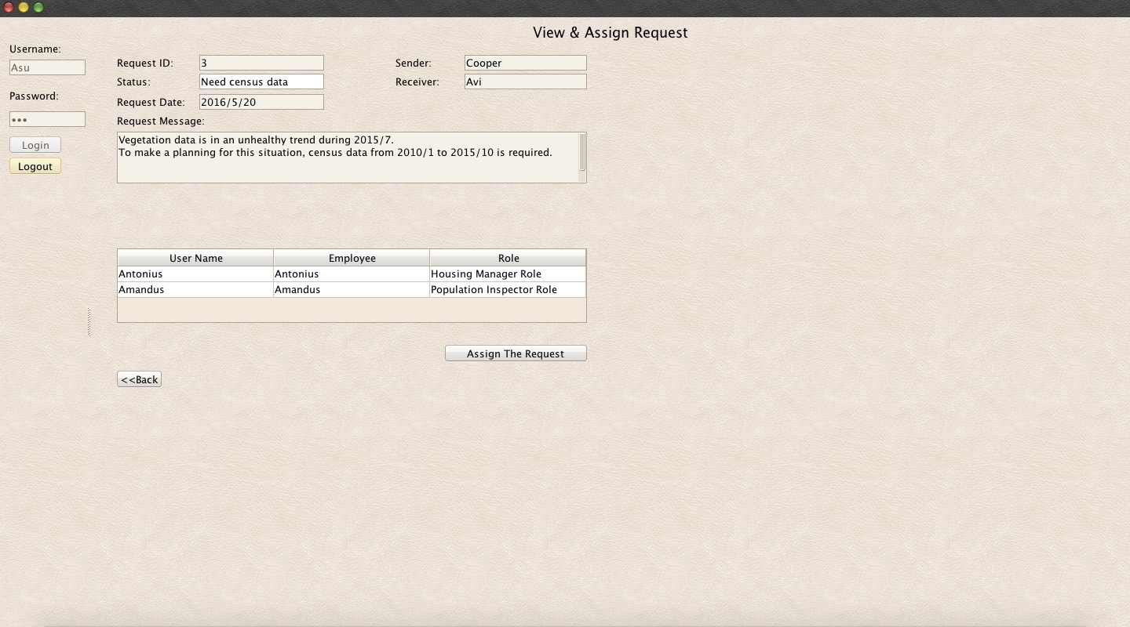

Slide 23
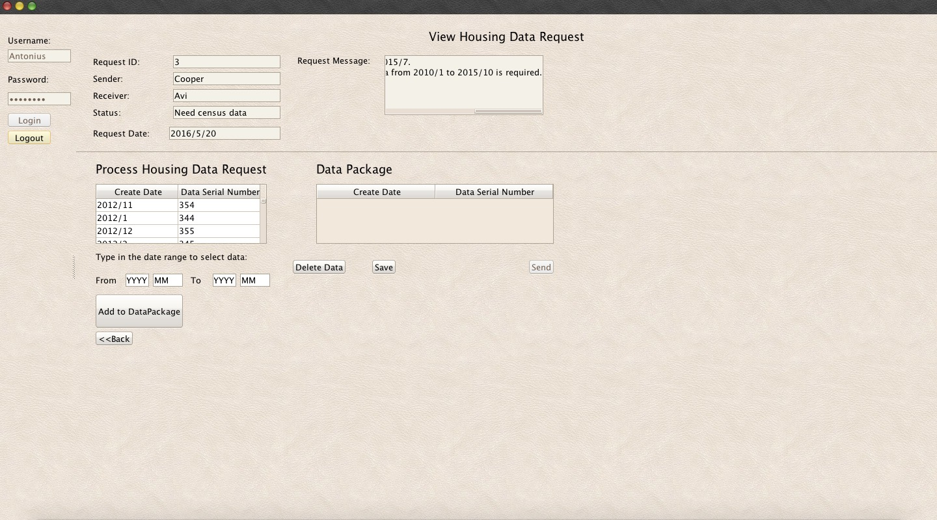

Slide 24
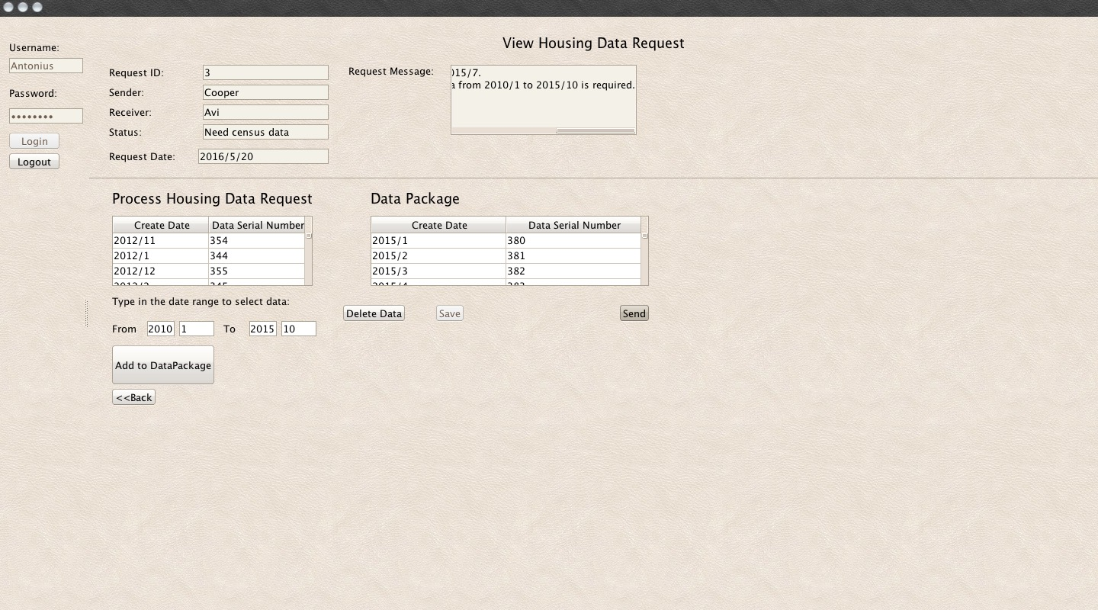

Slide 25
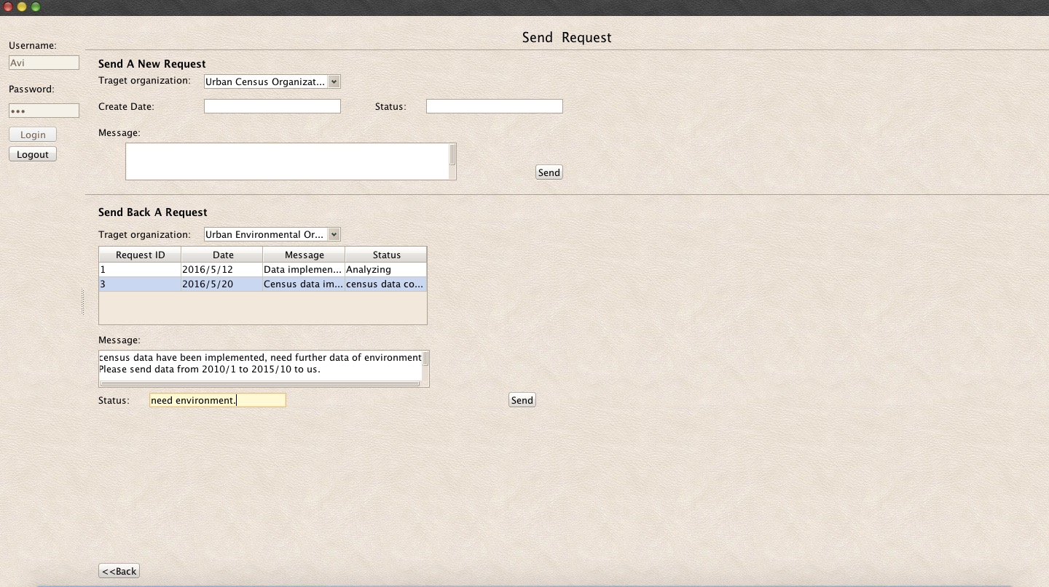

Slide 26
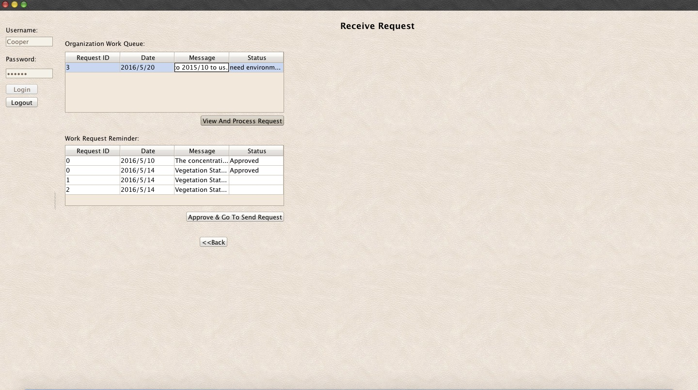

Slide 27
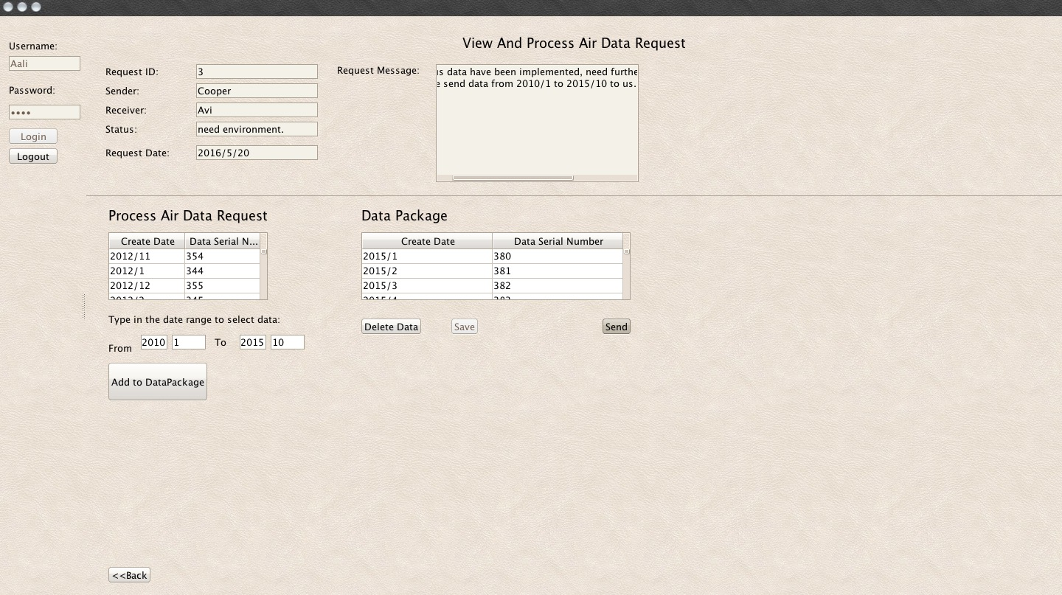

Slide 28
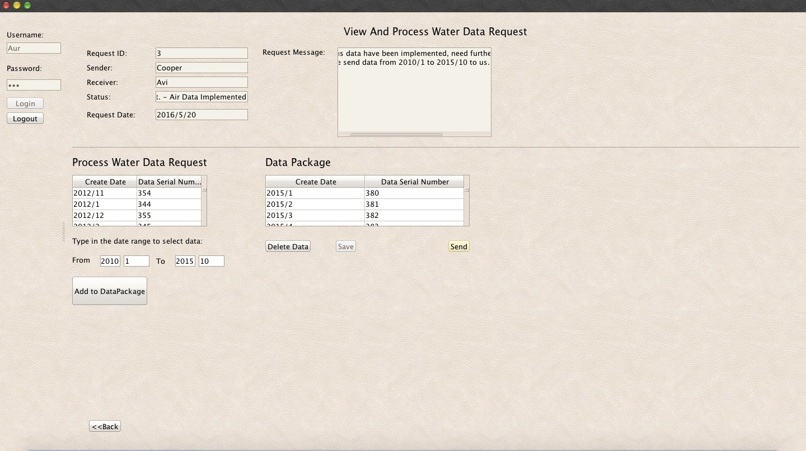

Slide 29
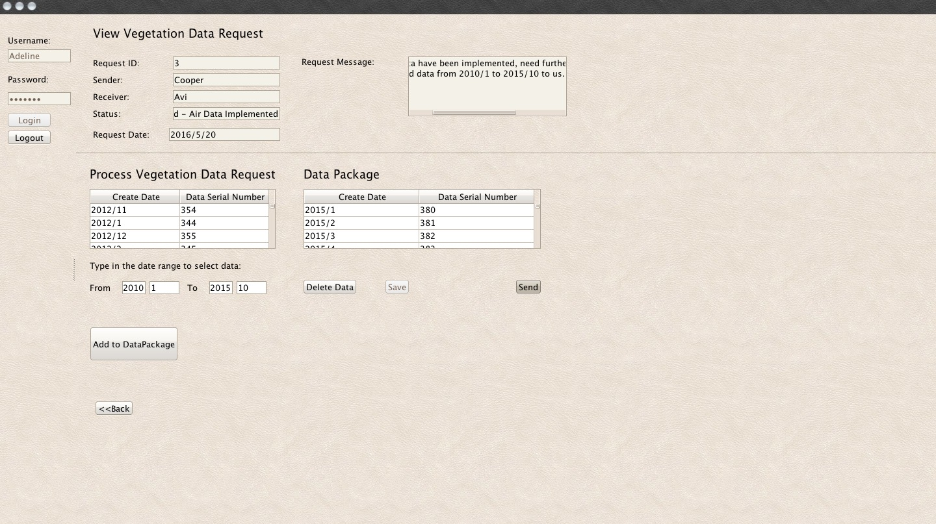

Slide 30
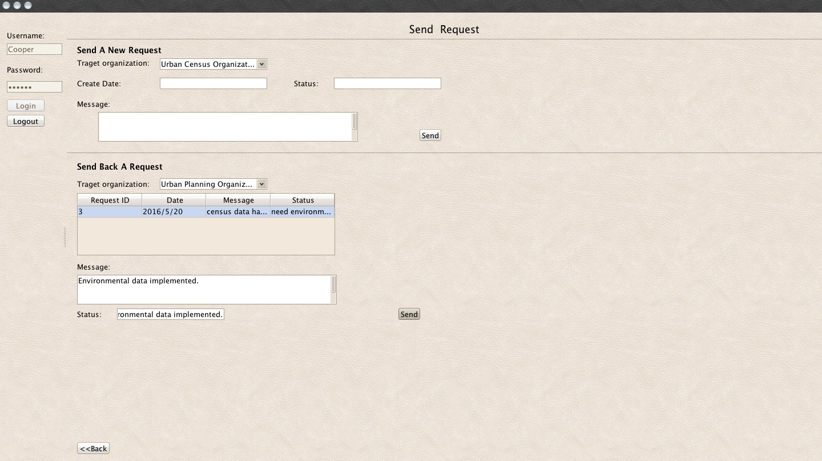

Slide 31
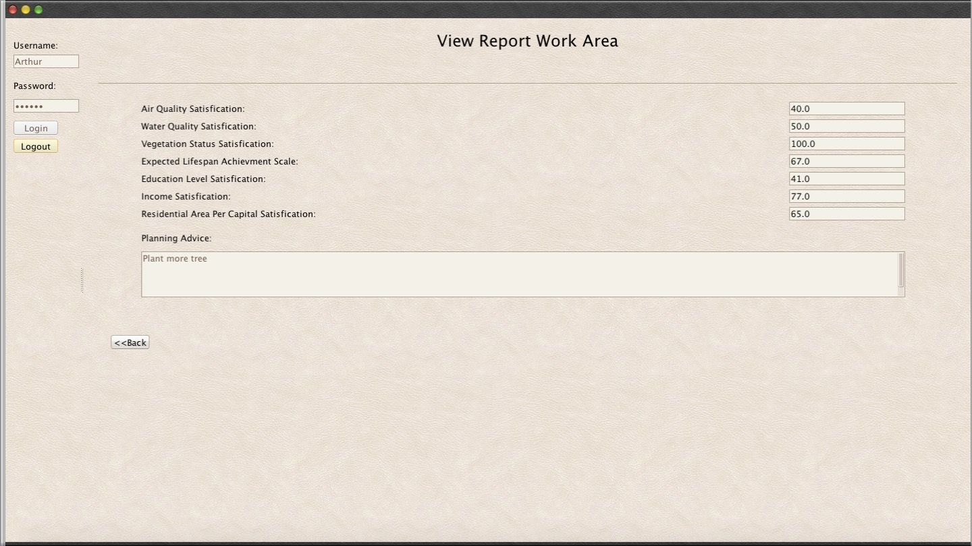

Slide 33
Q&A?

